Slide 1
Data Warehousing SS ZG515
PC Reddy
Guest Faculty – WILP, BITS Pilani

Slide 2
Data Warehousing – Lecture 8
OLAP

Slide 3
Lecture 8 Outline
Review Lecture 7, Aggregates, snowflake schema
OLAP.
Operations on MDS (Cubes)

Slide 4
ETL Processing
ETL Process
DIM 1
Fact
Source
Staging
DIM 2
DIM 3
Process of loading Data into Data Mart

Slide 5
BI/reporting Process
1:M
DIM 1
1:M
Fact
1:M
DIM 3
DIM 2

Slide 6
Where Does OLAP Fit In? (1)
OLAP = On-line analytical processing.
OLAP is a characterization of applications, not a database design technique.
Idea is to provide very fast response time in order to facilitate iterative decision-making.
Analytical processing requires access to complex aggregations (as opposed to record-level access).

Slide 7
Where Does OLAP Fit In? (2)
Information is conceptually viewed as “cubes” for simplifying the way in which users access, view, and analyze data.
Quantitative values are known as “facts” or “measures.”
e.g., sales $, units sold, etc.
Descriptive categories are known as “dimensions.”
e.g., geography, time, product, scenario (budget or actual), etc.
Dimensions are often organized in hierarchies that represent levels of detail in the data (e.g., UPC, SKU, product subcategory, product category, etc.).

Slide 8
Need for
Multidimensional Analysis
A simple analysis
How many units of product A did we sell in the store in Racine, WI
Typically, decision support requires more complex analyses
How much revenue did the new product X generate during the last three months, broken down by individual months, in the Southern Region, by individual stores, broken down by the promotions, compared to estimates, and compared to the previous version of the the product?

Slide 9
Different ways of Analysis
Roll-ups to provide summaries and aggregates along the hierarchies of the dimensions
Drill-downs from the top level to the lowest along the hierarchies of the dimensions
Calculations involving facts and metrics
Algebraic equations involving key performance indicators
Moving averages and growth percentages
Trend analyses using statistical methods

Slide 10
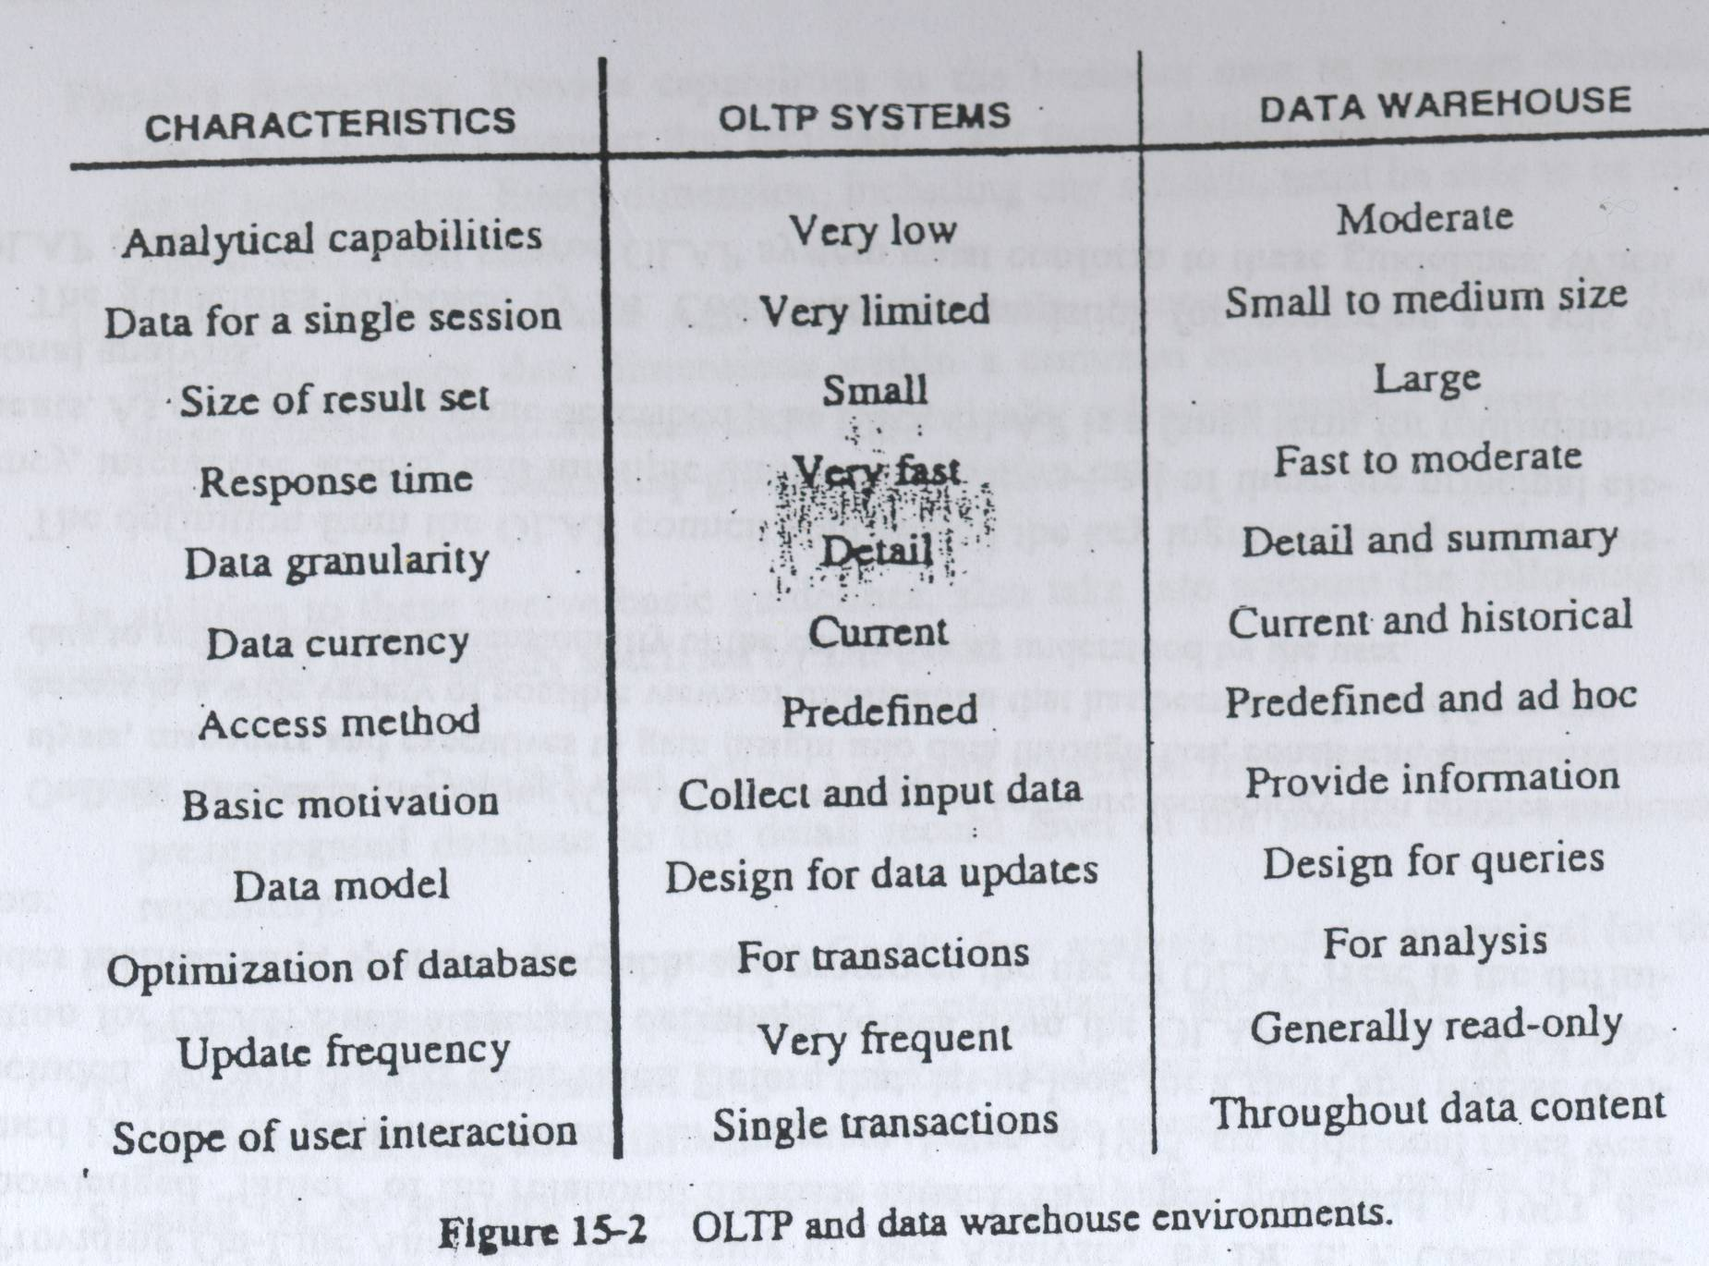
OLTP vs OLAP

Slide 11
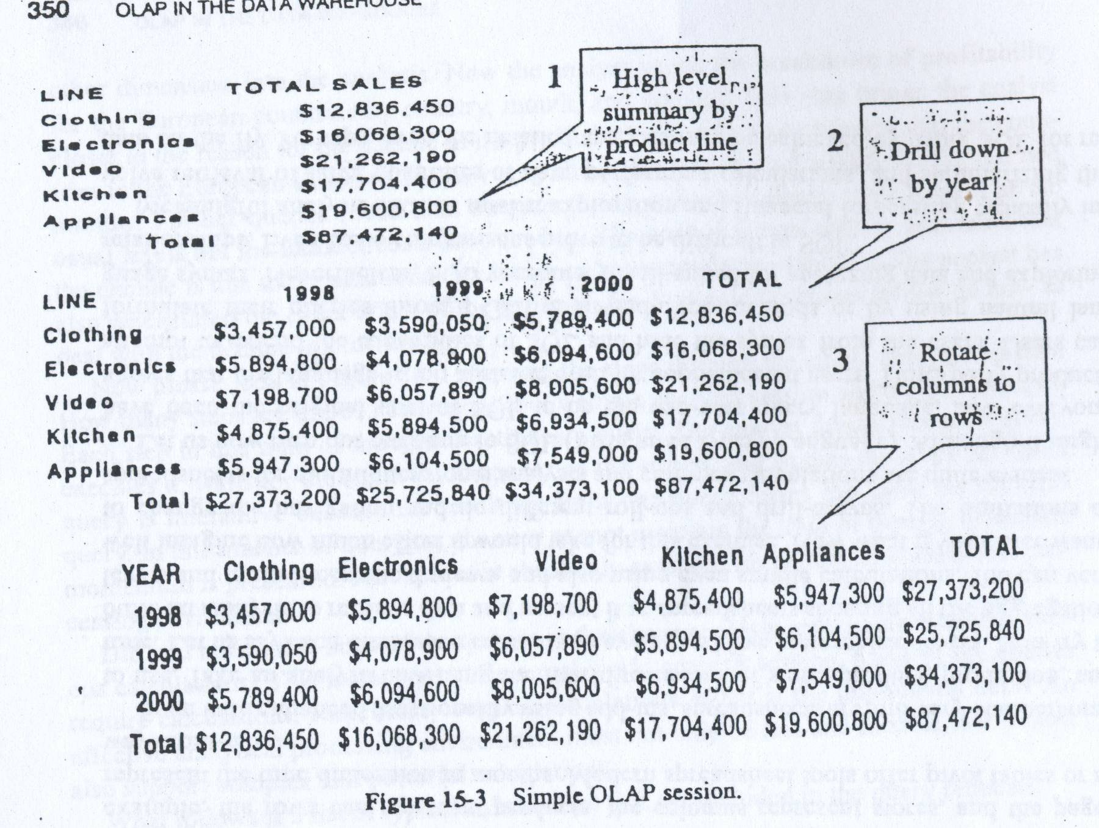
OLAP

Slide 12
OLAP
The name On-Line Analytical Processing was coined in a paper by E.F. Codd in 1993 (“Providing On-Line Analytical Processing for User Analysts”)
A definition
OLAP is a category of software technology that enables analysts, managers, and executives to gain insight into data through fast, consistent, interactive access in a a wide variety of possible views of information that has been transformed from raw data to reflect the real dimensionality of the enterprise as understood by the user

Slide 13
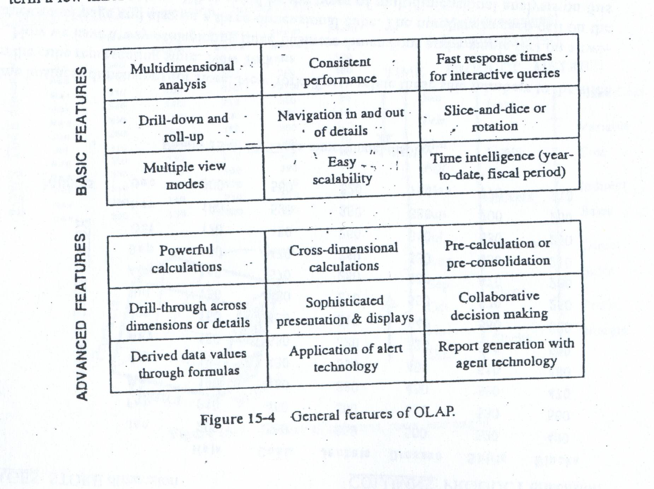
OLAP Features

Slide 14
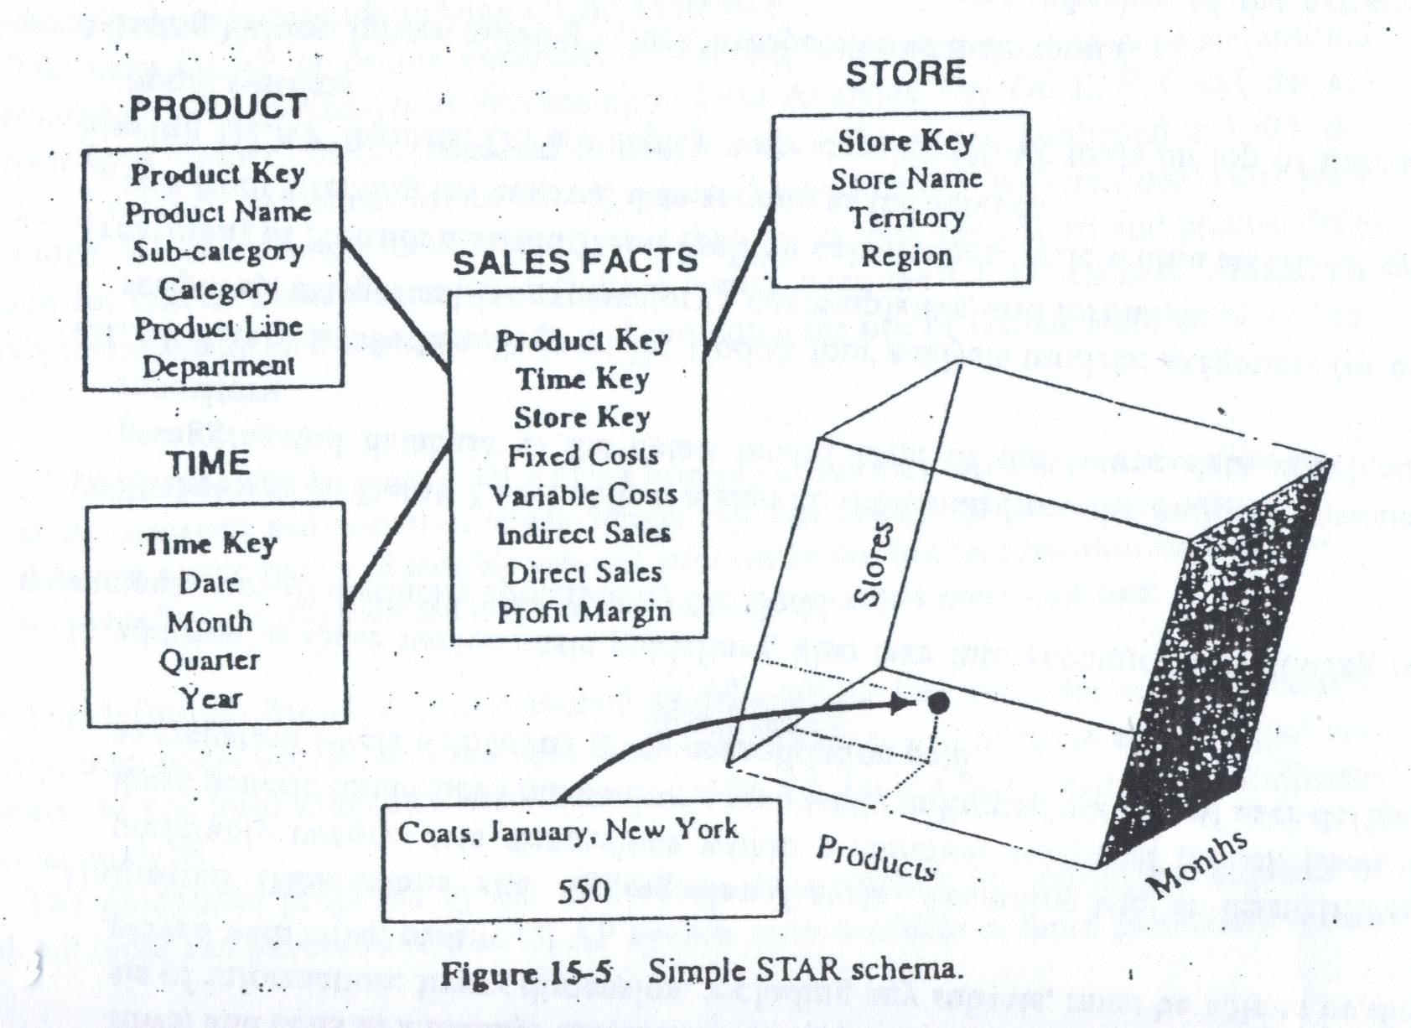
Dimensional Analysis (1)

Slide 15
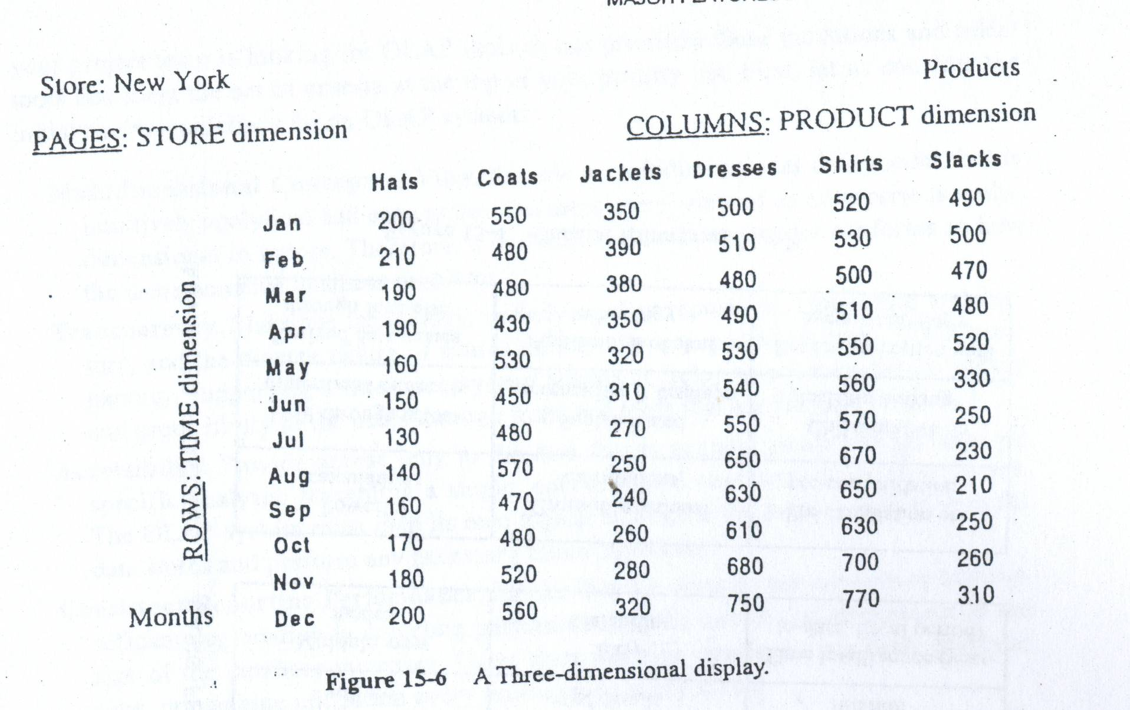
Dimensional Analysis (2)

Slide 16
Some Queries
Display the total sales of all products for past five years in all stores
Compare total sales for all stores, product by product, between years 2000 and 1999.
Show comparison of sales by individual stores, product by product, between years 2000 and 1999 only for those products with reduced sales.
Show the results of the previous queries, but rotating the columns with rows

Slide 17
Hypercubes
Multi-dimension cubes
Hard to visualize and display beyond three dimensions
Multi-dimensional domain structure (MDS)
Represents each dimension as a line showing the values
A multidimensional database (MDD) is a computer software system designed to allow for the efficient and convenient storage and retrieval of large volumes of data that is (1) intimately related and (2) stored, viewed and analyzed from different perspectives. These perspectives are called dimensions

Slide 18
Relational Vs
Multi-Dimensional Models
The Relational Structure

Slide 19
Relational Vs
Multi-Dimensional Models
Multidimensional Array Structure
Measurement
Dimension
Dimension
Positions

Slide 20
Relational Vs
Multi-Dimensional Models
Multidimensional array structure represents a higher level of organization than the relational table
Perspectives are embedded directly into the structure in the multidimensional model
All possible combinations of perspectives containing a specific attribute (the color BLUE, for example) line up along the dimension position for that attribute.
Perspectives are placed in fields in the relational model - tells us nothing about field contents.

Slide 21
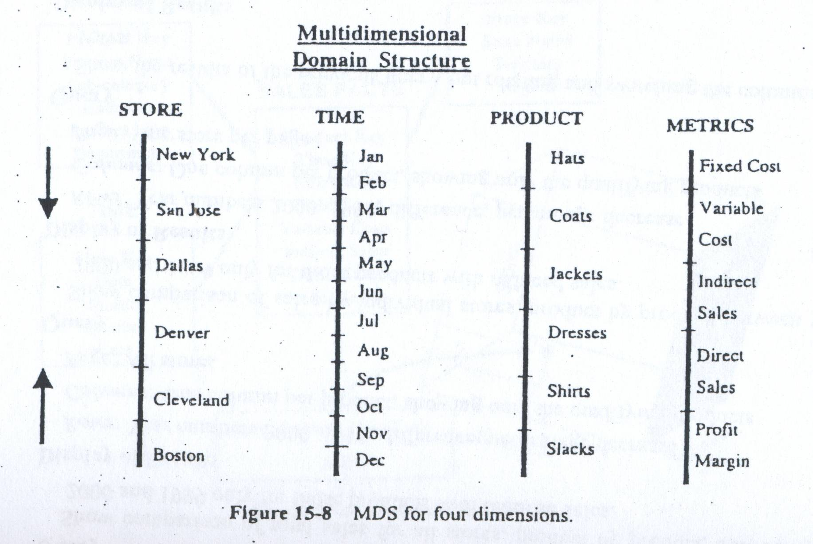
MDS

Slide 22
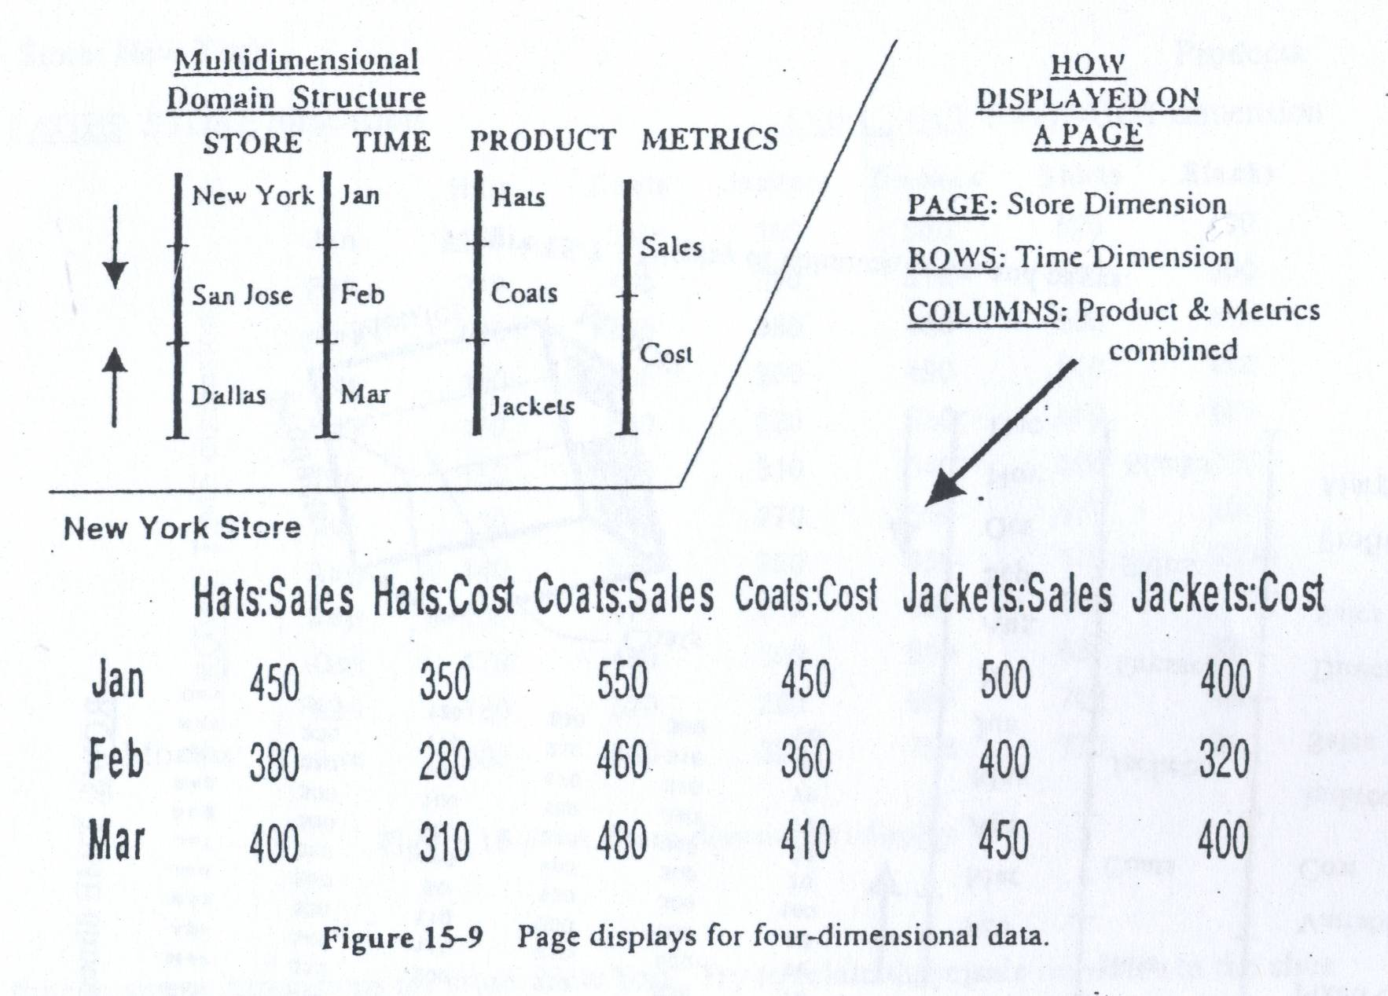
Display of Hypercubes

Slide 23
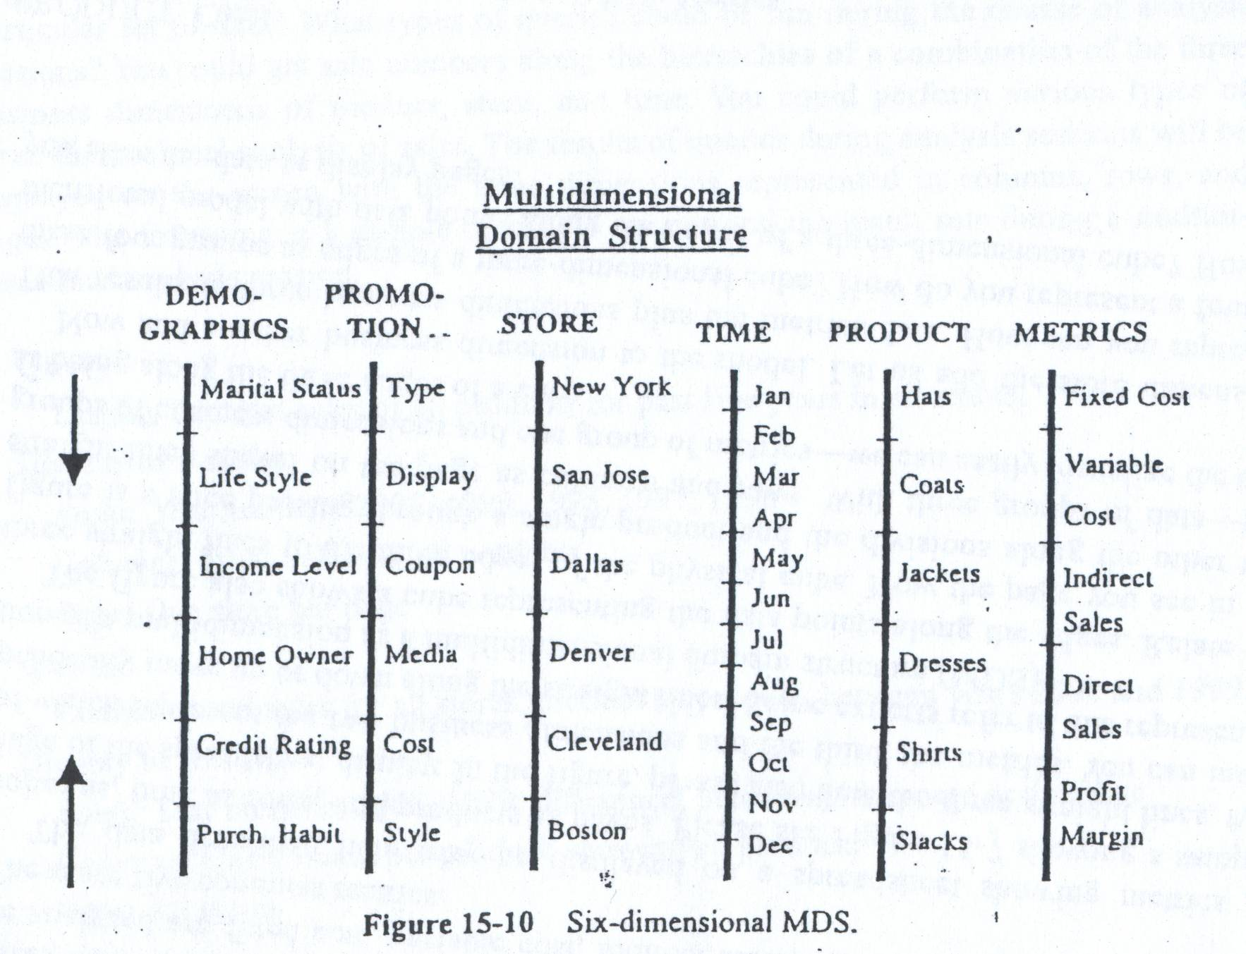
MDS

Slide 24
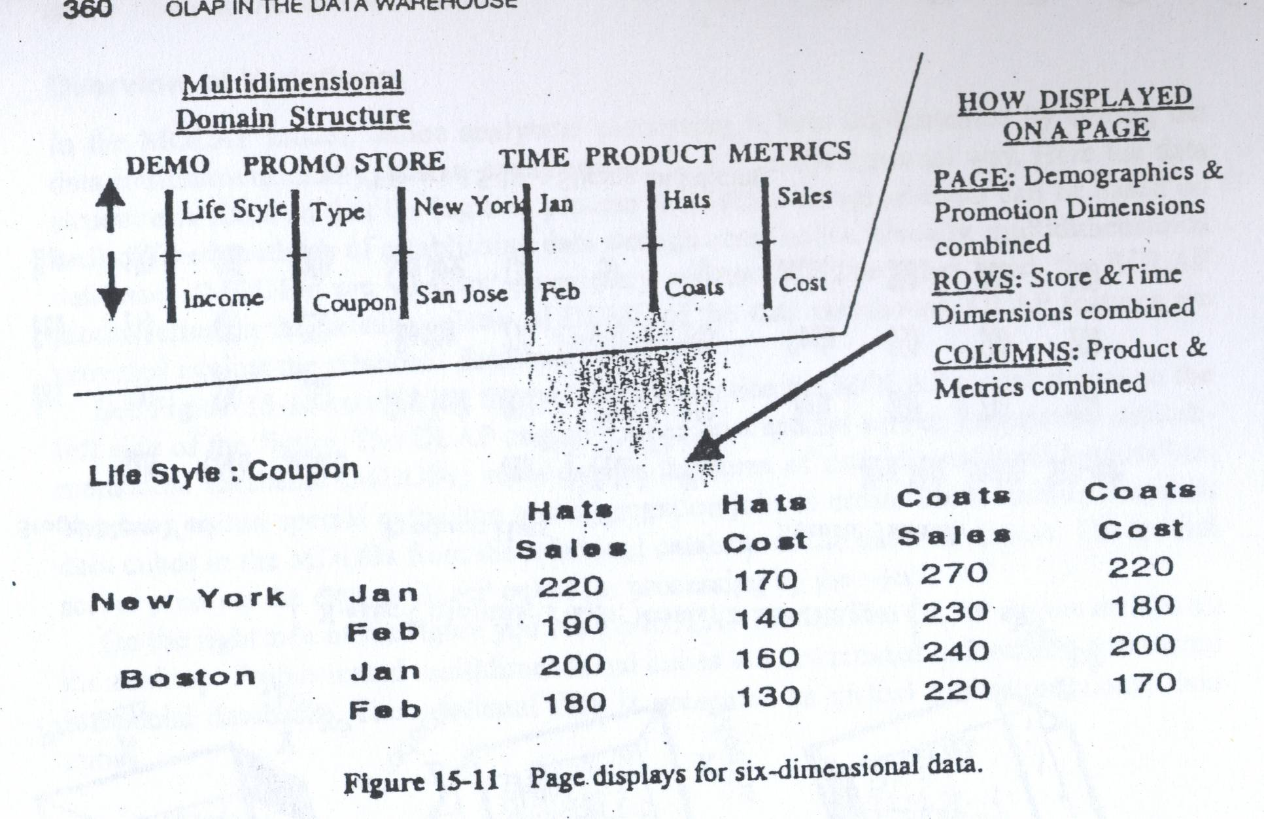
Display of Hypercubes

Slide 25
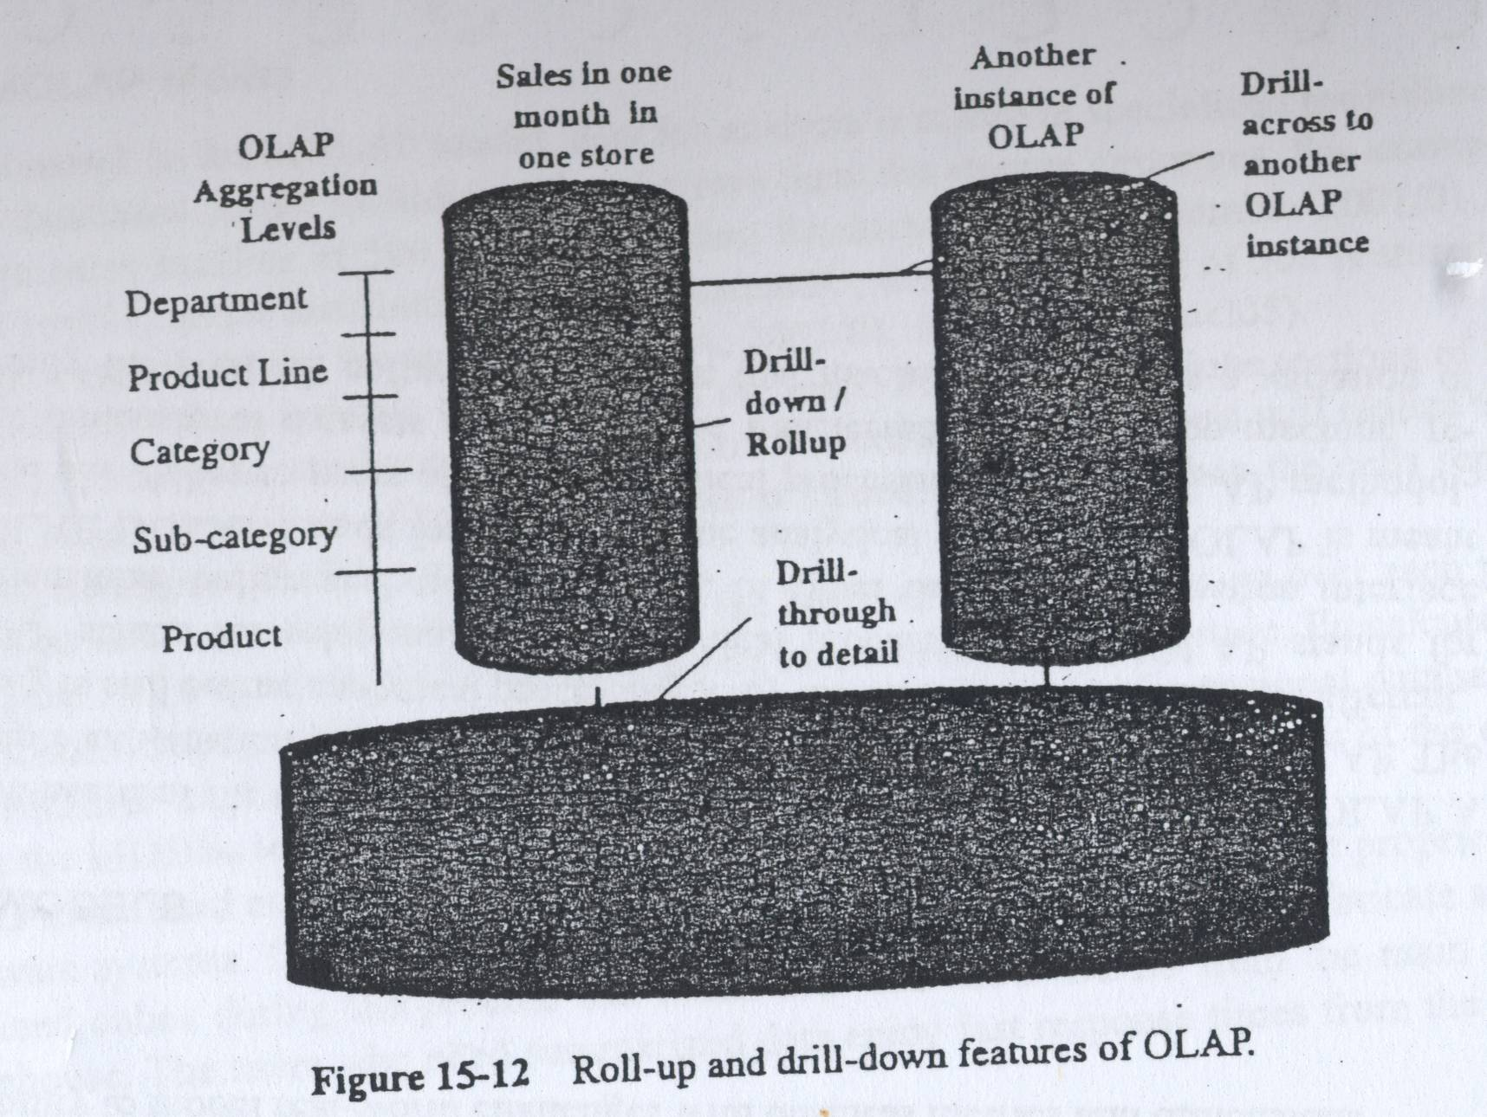
Drill-Down and Roll-Up

Slide 26
Slice or Rotation
Also referred to as “data slicing.”
Each rotation yields a different slice or two dimensional table
of data.

Slide 27
Dice or Range
The end user selects the desired positions along each dimension.
Also referred to as "data dicing."
The data is scoped down to a subset grouping

Slide 28
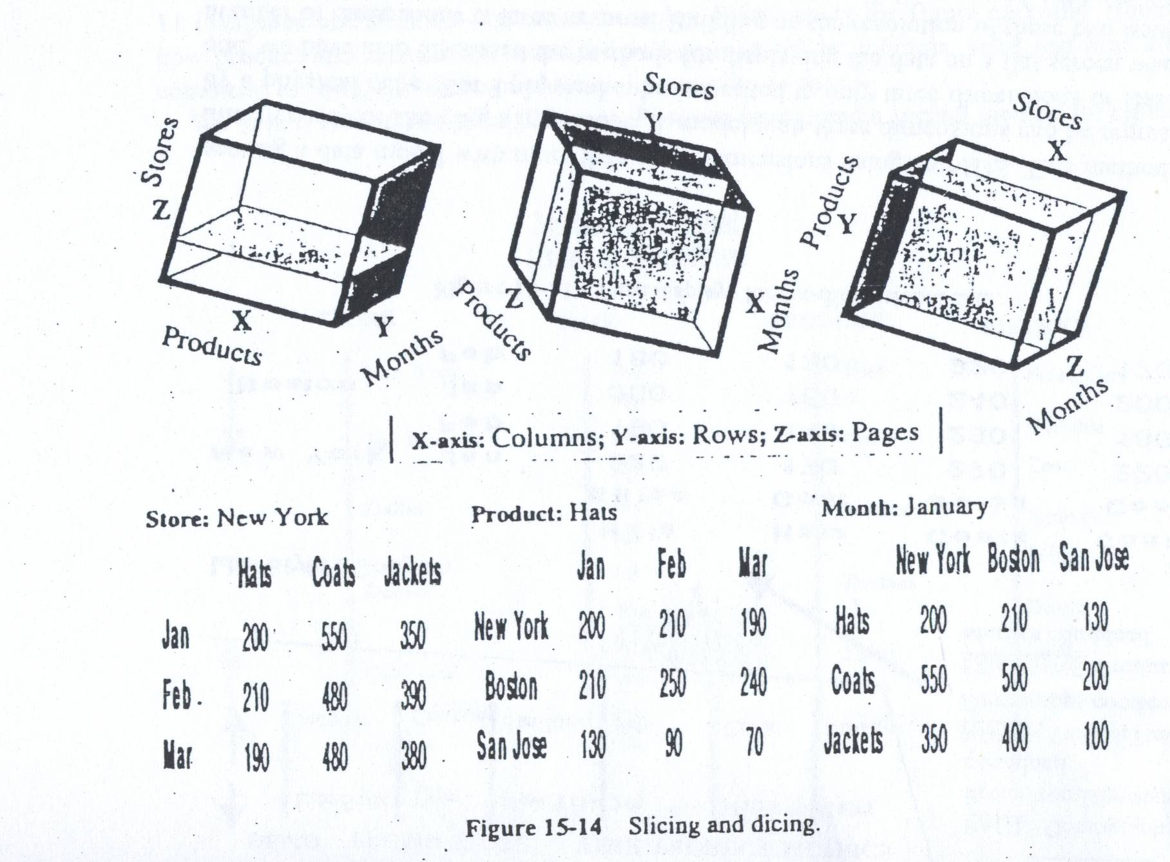
Slice-and-Dice or Rotation

Slide 29
MOLAP Implementations
OLAP has historically been implemented through use of multi-dimensional databases (MDDs).
Dimensions are key business factors for analysis:
geographies (zip, state, region,...)
products (item, product category, product department,...)
dates (day, week, month, quarter, year,...)
Very high performance via fast look-up into “cube” data structure to retrieve pre-calculated results.
“Cube” data structures allow pre-calculation of aggregate results for each possible combination of dimensional values.
Use of application programming interface (API) for access via front-end tools.

Slide 30
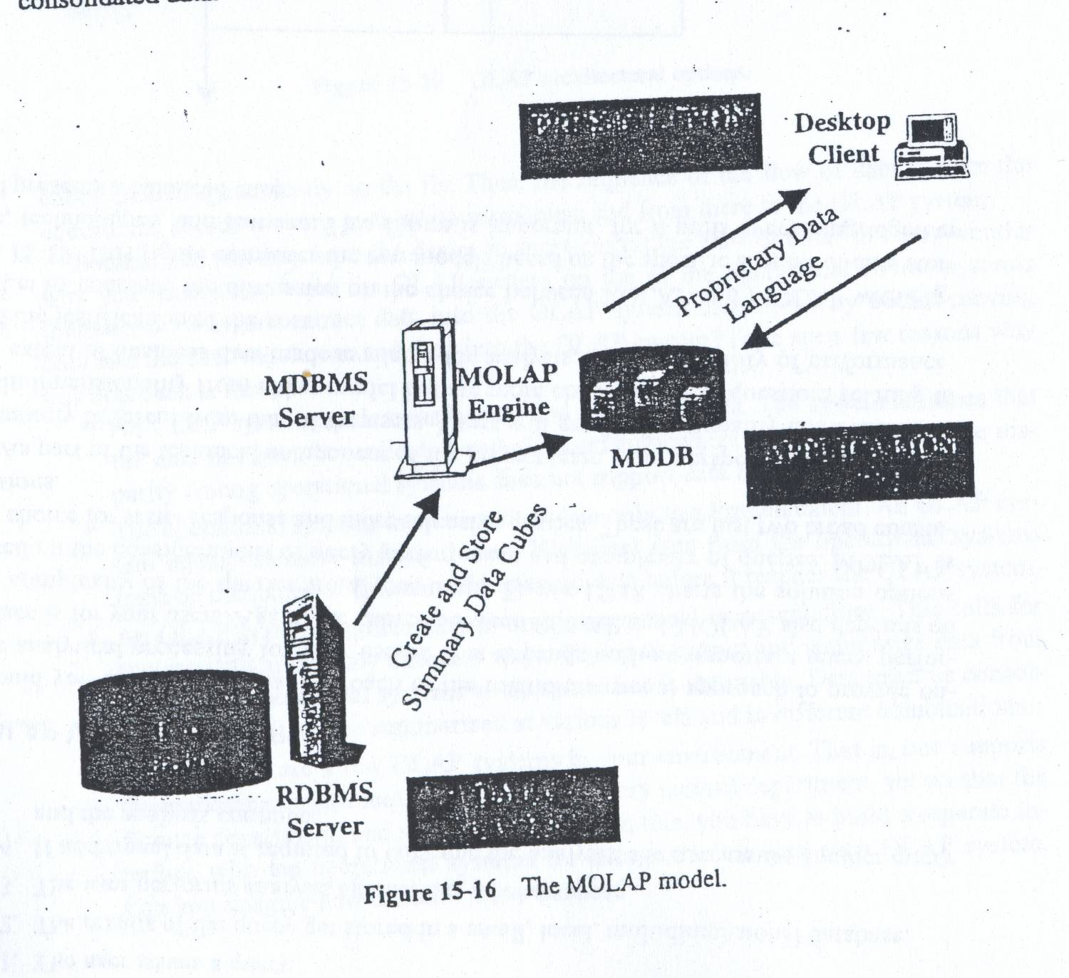
MOLAP Implementations

Slide 31
MOLAP Implementations
Need to consider both maintenance and storage implications when designing strategy for when to build cubes.
Maintenance Considerations: Every data item received into MDD must be aggregated into every cube (assuming “to-date” summaries are maintained).
Storage Considerations: Although cubes get much smaller (e.g., more dense) as dimensions get less detailed (e.g., year vs. day), storage implications for building hundreds of cubes can be significant.

Slide 32
Virtual Cubes
Virtual cubes are used when there is a need to join information from two dissimilar cubes that share one or more common dimensions.
Similar to a relational view; two (or more) cubes are linked along common dimension(s).
Often used to save space by eliminating redundant storage of information.

Slide 33
Partitioned Cubes
One logical cube of data can be spread across multiple physical cubes on separate (or same) servers.
The divide-and-conquer approach of partitioned cubes helps to mitigate the scalability limitations of a MOLAP environment.
Ideal cube partitioning is completely invisible to end users.

Slide 34
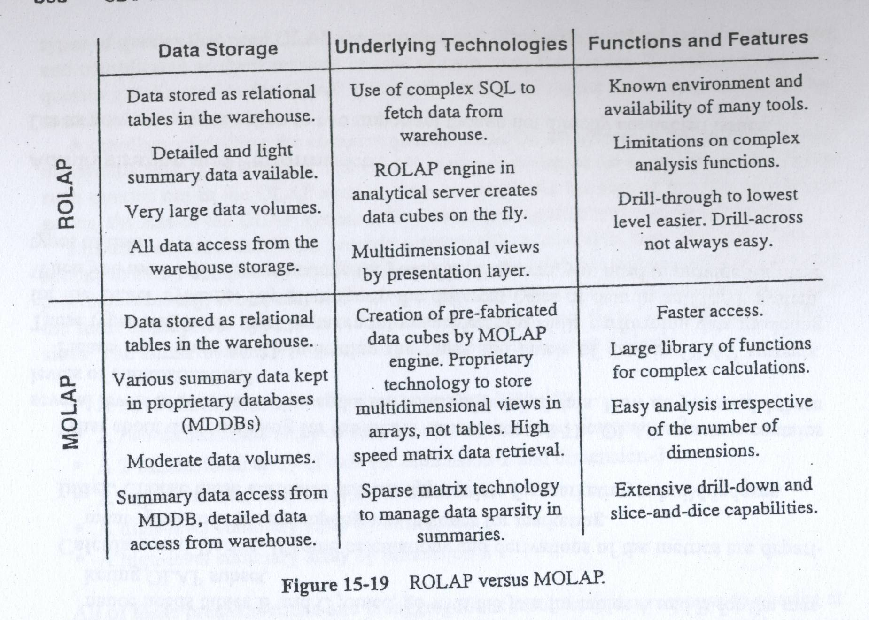
MOLAP vs ROLAP

Slide 35
Bottom Line
There are many implementation techniques for delivery of an OLAP environment.
Must fully consider the performance, scalability, complexity, and flexibility characteristics when deciding between MOLAP and ROLAP.
Understand your tools and RDBMS!

